Slide 1
Chapter 15
Further Dependencies and Normalization

Slide 2
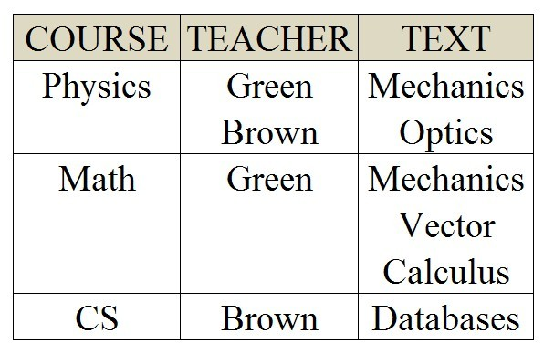
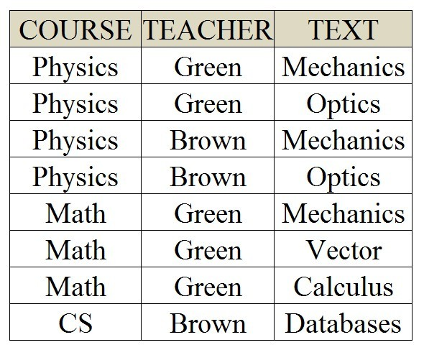

Problem Relation
For each course, there are fixed number of teachers
COURSE →→ TEACHER
For each course, there are fixed number of texts
COURSE →→ TEXT.
1NF?
2NF?
3NF?
BCNF?
Any problem with
Insertion
Deletion
Update

Slide 3
Multivalued Dependencies
A multivalued dependency (MVD) X →→ Y specified on relation schema R, where X and Y are both subsets of R, specifies the following constraint on any relation instance r of R: If two tuples t₁ and t₂ exist in r such that t₁[X] = t₂[X], then two tuples t₃ and t₄ should also exist in r with the following properties, where we use Z to denote (R - (X ∪ Y)):
t₃.X = t₄.X = t₁.X = t₂.X
t₃.Y = t₁.Y and t₄.Y = t₂.Y
t₃.Z = t₂.Z and t₄.Z = t₁.Z
An MVD X →→ Y in R is called a trivial MVD if
(a) Y is a subset of X, or
(b) X ∪ Y = R.

Slide 4
Multivalued Dependencies (MVD)
t₁
t₃
t₄
t₂
t₁t₄
t₃t₂
t_{1..}t₄
X →→ Y: If t₁ and t₂ exist in r such that t₁.X = t₂.X, then t₃ and t₄ should also exist:
t₁.X = t₂.X =t₃.X = t₄.X
t₁.Y = t₃.Y and t₂.Y = t₄.Y
t₁.Z = t₄.Z and t₂.Z = t₃.Z
where Z = (R - (X ∪ Y)):
X = COURSE
Y = TEACHER
Z = TEXT

Slide 5
Multivalued Dependencies (MVD)
MVDs: COURSE →→ TEACHER and COURSE →→ TEXT.

Slide 6
Inference Rules for FD and MVD
R1 (reflexive rule for FDs): If X ⊇ Y, then X → Y.
R2 (augmentation rule for FDs): X → Y ⊨ XZ → YZ.
R3 (transitive rule for FDs): X → Y, Y →Z ⊨ X → Z.
R4 (complementation rule for MVDs):
X→→Y ⊨ X→→ (R － (X ∪ Y)).
R5 (augmentation rule for MVDs): If X →→ Y and W ⊇ Z then WX →→ YZ.
R6 (transitive rule for MVDs):
X →→ Y, Y→→ Z ⊨ X →→ (Z －Y).
R7 (replication rule for FD to MVD): {X → Y} ⊨ X →→ Y.
R8 (coalescence rule for FDs and MVDs): If X →→ Y and there exists W with the properties that
(a) W ∩ Y is empty, (b) W → Z, and (c) Y ⊇ Z, then X → Z.

Slide 7
Inference Rules R4
R4 (complementation rule for MVDs): {X→→Y} ⊨ X→→ (R － (X ∪ Y)).
COURSE →→ TEXT ⊨ COURSE→→ TEACHER

Slide 8
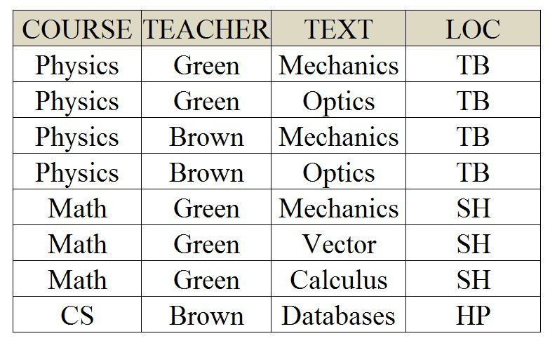
Inference Rules R5
R5 (augmentation rule for MVDs):
If X →→ Y and W ⊇ Z then WX →→ YZ.
Special case: If X →→ Y then WZ →→ YZ.
COURSE →→ TEXT ⊨ COURSE,LOC→→TEXT,LOC

Slide 9
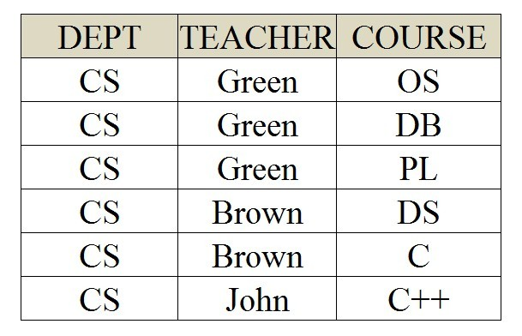
Inference Rules R6
R6 (transitive rule for MVDs):
{X →→ Y, Y→→ Z} ⊨ X →→ (Z －Y).
Special case: {X →→ Y, Y→→ Z} ⊨ X →→ Z
DEPT→→TEACHER,TEACHER→→COURSE
⊨ DEPT→→COURSE

Slide 10
Inference Rules R7
Student
S# | SNAME | AGE
1000 | John | 25
2000 | Kate | 24
3000 | Tony | 20
R7 (replication rule for FD to MVD): {X → Y} ⊨ X →→ Y
S#→ SNAME ⊨ S#→→ SNAME
S#→ AGE ⊨ S#→→AGE
Such a MVD is called a trivial MVD
Why?
How about X →→ Y ⊨ X → Y ?

Slide 11
Disproof of a MVD
⊨ X →→ Y.
x₁ →→ y₁,y₂ with z₁
x₁ →→ y₃ with z₂
for a given X, we don't have a fixed set of Z values associate with it
Z | X | Y
z₁ | x₁ | y₁
z₁ | x₁ | y₂
z₂ | x₁ | y₃

Slide 12
Multivalued Dependencies (MVD)
MVDs: COURSE →→ TEACHER and COURSE →→ TEXT.
Any problem with this normalized relation?

Slide 13
Fourth Normal Form
A relation schema R is in 4NF with respect to a set of dependencies F (both functional dependencies and multivalued dependencies) if there is at most one nontrivial MV dependency in R.

Slide 14
4th Normalization
COURSE | TEACHER
Physics | Green
Physics | Brown
Math | Green
Math | Green
Math | Green
CS | Brown
COURSE | TEXT
Physics | Mechanics
Physics | Optics
Math | Mechanics
Math | Vector
Math | Calculus
CS | Databases

Slide 15
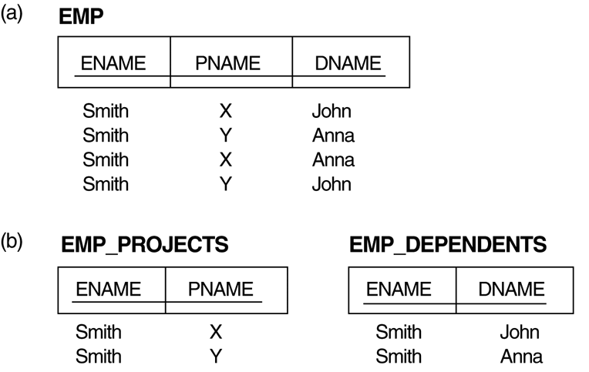
Multivalued Dependencies
Two MVDs: ENAME →→ PNAME and ENAME →→ DNAME.
Decomposing the EMP relation into two 4NF relations EMP_PROJECTS and EMP_DEPENDENTS.

Slide 16
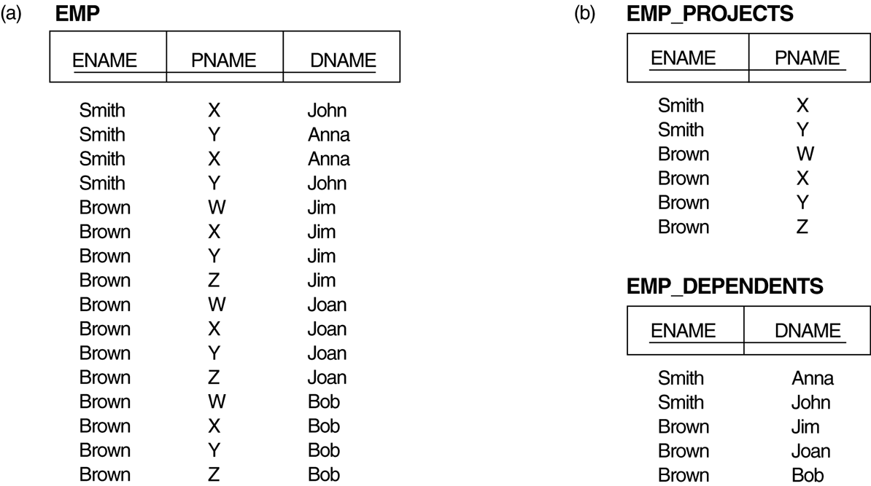
Multivalued Dependencies and 4NF
Decomposing a relation state of EMP that is not in 4NF:
EMP relation with additional tuples.
Two corresponding 4NF relations EMP_PROJECTS and EMP_DEPENDENTS.

Slide 17
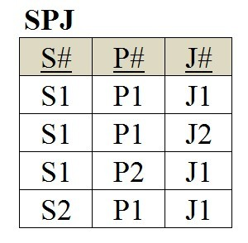
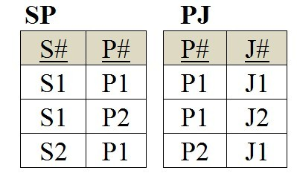
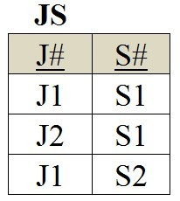
Can we further decompose 4NF relations?

Slide 18
Join Dependencies
A join dependency (JD), denoted by JD(R₁, R₂, ..., R_{n}), specified on relation schema R, specifies a constraint on the states r of R.
The constraint states that every legal state r of R should have a non-additive join decomposition into R₁, R₂, ..., R_{n}; that is, for every such r we have
* (π_{R1}(r), π_{R2}(r), ..., π_{Rn}(r)) = r
Note: an MVD is a special case of a JD where n = 2.
A join dependency JD(R₁, R₂, ..., R_{n}), specified on relation schema R, is a trivial JD if one of the relation schemas R_{i} in JD(R₁, R₂, ..., R_{n}) is equal to R.

Slide 19
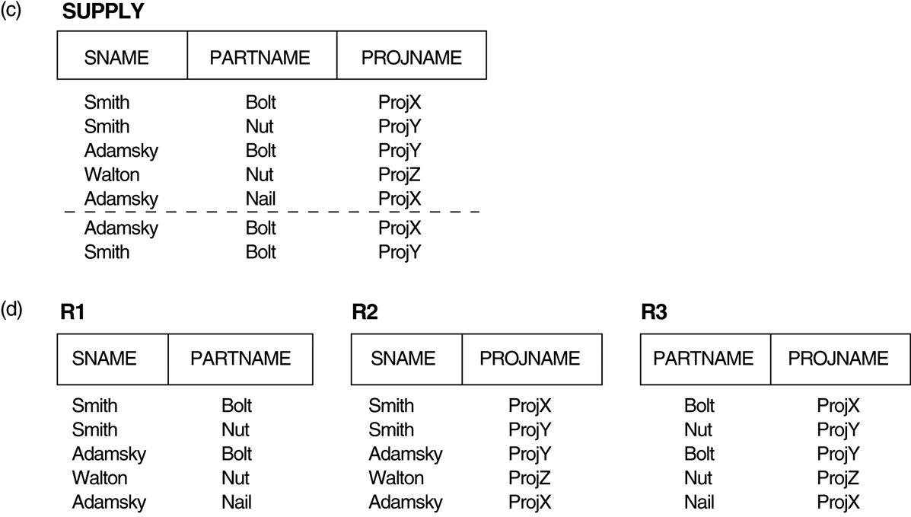
Multivalued Dependencies and Fourth 4NF
(c) The relation SUPPLY with no MVDs is in 4NF but not in 5NF if it has the JD(R1, R2, R3). (d) Decomposing the relation SUPPLY into the 5NF relations R1, R2, and R3.

Slide 20
Fifth Normal Form
A relation schema R is in fifth normal form (5NF) with respect to a set F of functional, multivalued, and join dependencies if,
for every nontrivial join dependency JD(R₁, R₂, ..., R_{n}) in F⁺ (that is, implied by F),
every R_{i} is a superkey of R.
In other words, the relation has no join dependencies.

Slide 21
Inclusion Dependencies
Definition:
An inclusion dependency R.X < S.Y between two sets of attributes—X of relation schema R, and Y of relation schema S—specifies the constraint that, at any specific time when r is a relation state of R and s a relation state of S, we must have
π_{X}(r(R)) ⊇ π_{Y}(s(S))
Note:
The ⊇ (subset) relationship does not necessarily have to be a proper subset.
The sets of attributes on which the inclusion dependency is specified—X of R and Y of S—must have the same number of attributes.
In addition, the domains for each pair of corresponding attributes should be compatible.

Slide 22
Dependency Diagram
A | B | C | D | E | F | G
D
A
F
C
E
B
G
C | D | E
A | B | C
A | F | G
D
A
A
F
C
C
E
B
G
C | D | E
A | B | C
A | F
F | G
D
A
A
G
C
C
E
B
G
F

Slide 23
Dependency Diagram
C | D | E
A | B | C
A | G
G | F
D
A
A
G
C
C
E
B
G
F
C | D | E
C | B
C | A
A | G
G | F
D
A
A
G
C
C
E
B
G
F

Slide 24
Dependency Diagram
C | D | E
C | B
C | A
A | G
G | F
D
A
A
G
C
C
E
B
G
F
C | D
C | E
C | B
C | A
A | G
G | F
D
C
A
A
G
C
E
C
B
G
F

